Slide 1

PID Control: Designing and Building a Control Algorithm
RoboLaunch Workshop Series
Friday, July 22nd, 2022
Brady Moon, Teodor Tchalakov, and Indu Panigrahi

Slide 2
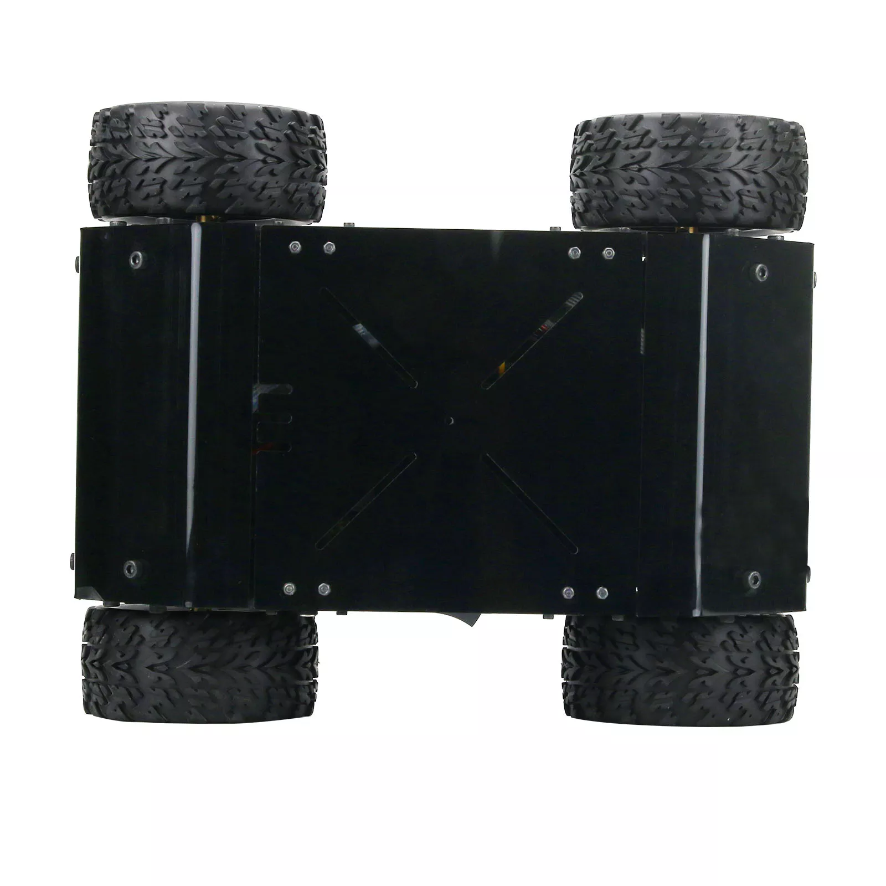


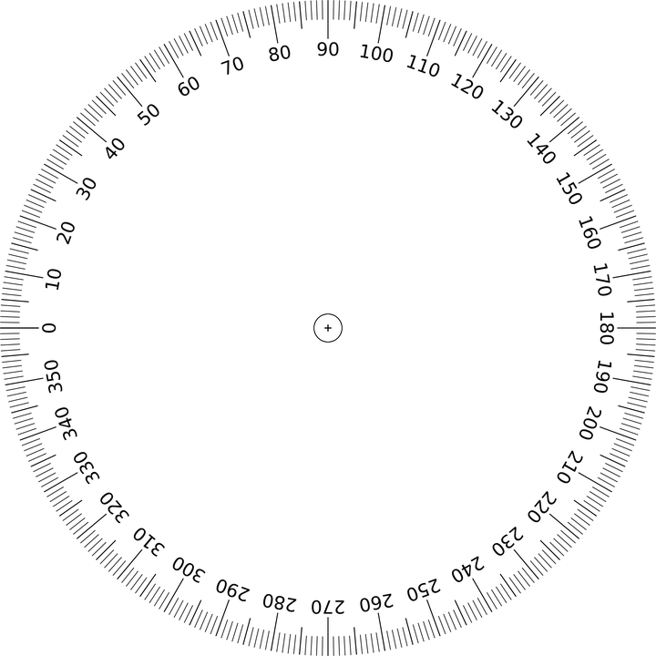

Remote Control Cars
Remote Control Car Top View
Accuracy Problem
Distance:
10 meters
Orientation:
Left and right sides can only spin forward and backward.
Wheels on each side spin together
Joystick controls power to the motors of the wheels
https://www.aliexpress.com/i/1005002761034182.html
https://www.target.com/c/electronics-deals/-/N-556x9
https://www.istockphoto.com/illustrations/car-clipart
https://flyclipart.com/sound-wave-icon-png-png-image-soundwave-png-338817
https://pixabay.com/vectors/circle-math-education-360-degree-41073/

Slide 3
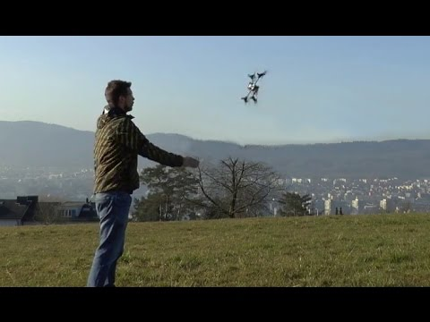
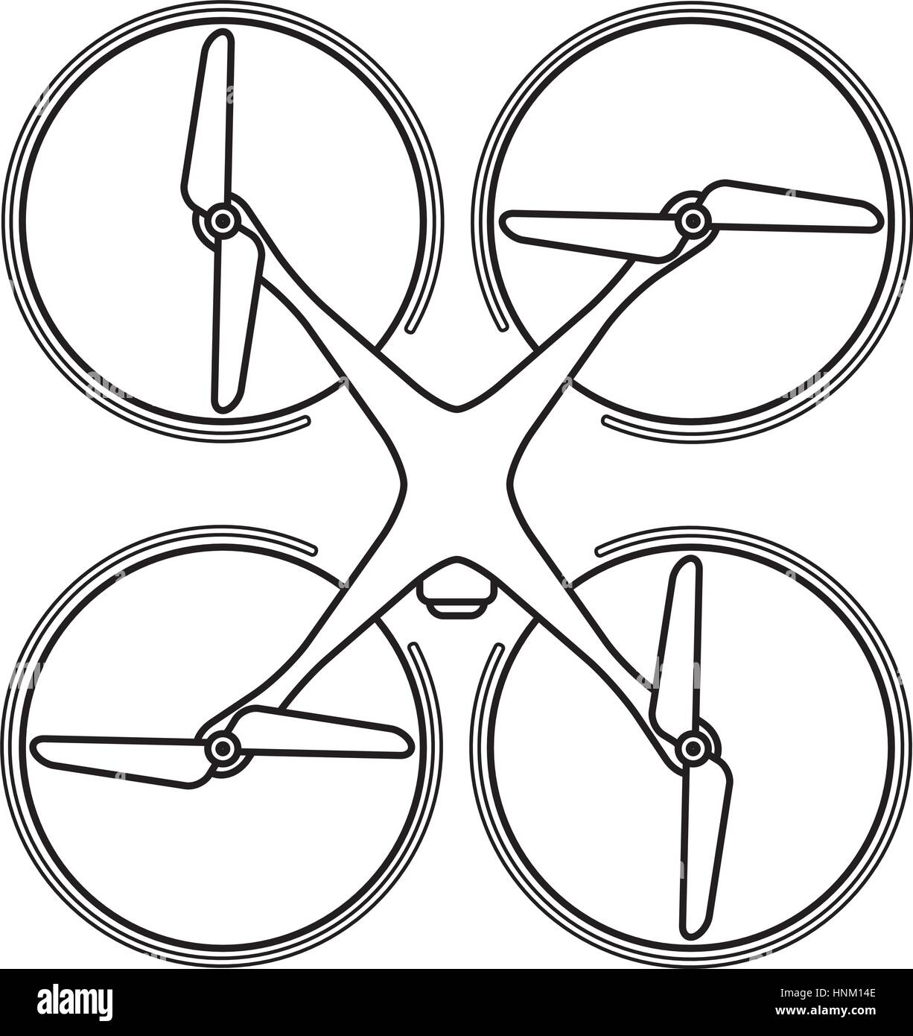
Quadcopter Control
Quadcopter Top View
Quadcopter Stabilization
Four motors with propeller
All equally spaced
https://youtu.be/pGU1s6Y55JI
https://www.alamy.com/stock-photo-modern-quadcopter-drone-with-camera-top-view-thin-line-linear-illustration-133820302.html

Slide 4
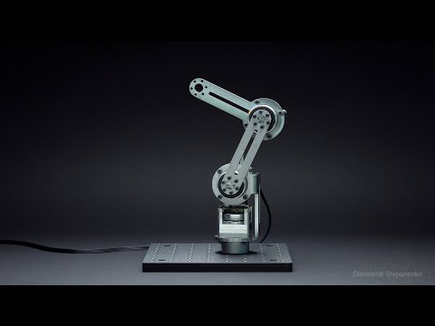
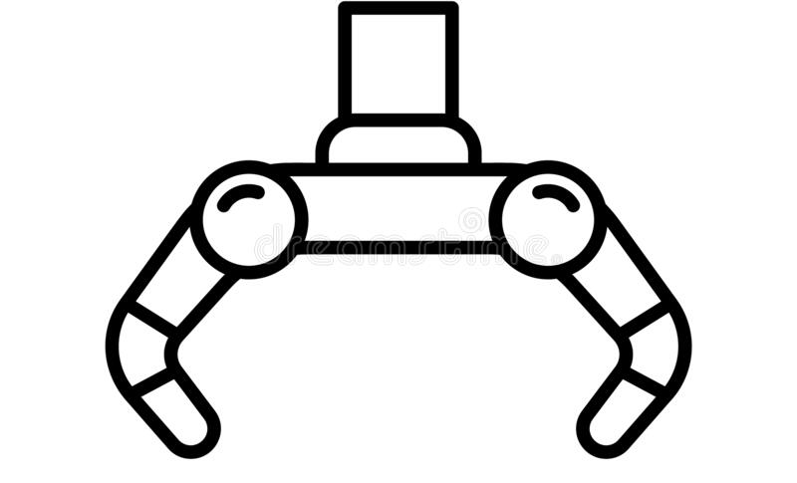
Simple Robot Arm
Simple Arm Side View
Similar Arm: Quick and Precise Movements
https://youtu.be/yhdL4jz74WM
Three joints with motors
Gripper at the end
https://www.dreamstime.com/illustration/grabber.html

Slide 5
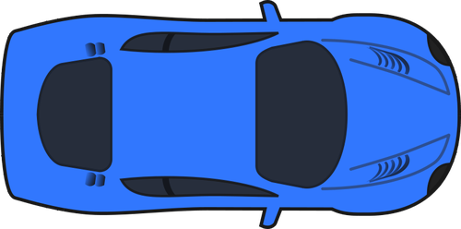

What is control and why use a control algorithm?
10 m
STOP
System: the car
Goal: stop at the crosswalk
Control: decide when to brake

Slide 6
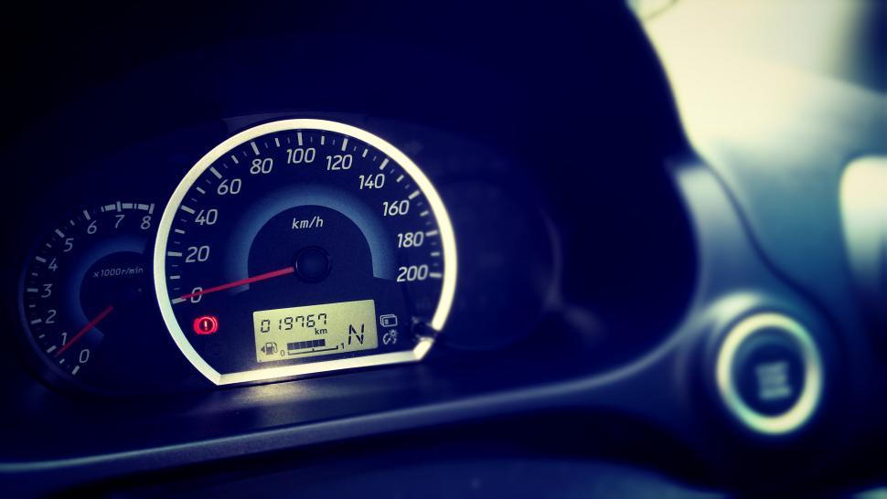
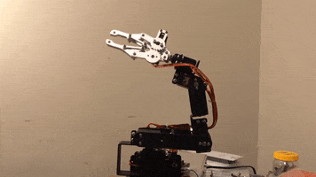
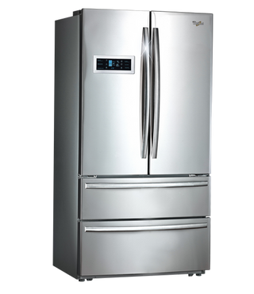
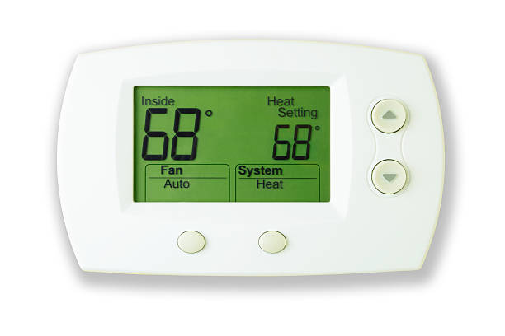
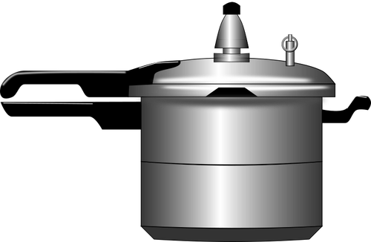
Control in Everyday Life and Robotics
https://media.giphy.com/media/v4sOCVX9Dhsv6/giphy.gif

Slide 7
Simple Arm
Simple Arm Side View
Gravity Acting on Pendulum
Resting Position
Motor at the dark grey dot

Slide 8
Task: Upright Arm

Slide 9
Task: Upright Arm Possible Positions
Possible Orientations
Right Half
Left Half
Solution:
Take shortest path to upright position

Slide 10
Task: Upright Arm Bang-Bang Controller
Bang Bang Control Algorithm
Goal (Set point): 0゜
Control Logic Rules:
If at 0゜do nothing
If measured degree is positive turn motor counterclockwise
If measured degree is negative turn motor clockwise
Note:
Motor will be run at a constant power in the desired direction
Describing the Location of the Arm
0゜
-90゜
90゜
+-180゜

Slide 11
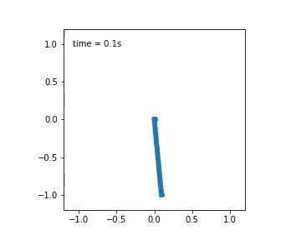
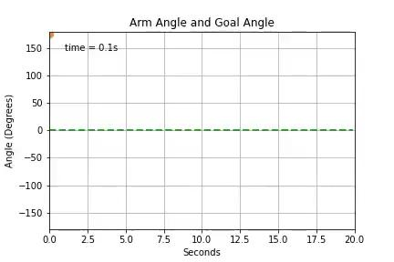
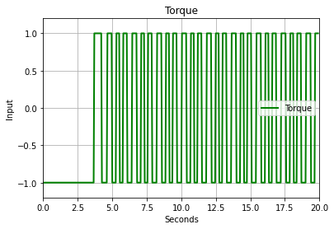
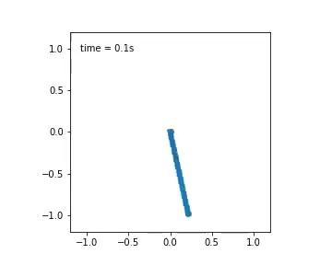
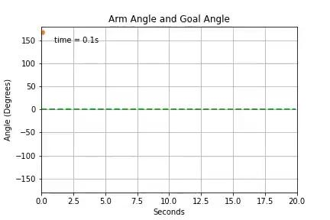
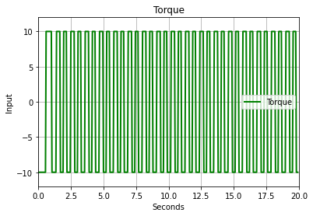
Task: Upright Arm Bang-Bang Overshoot
Good Case
Bad Case (High Constant Motor Power)

Slide 12
Task: Upright Arm P Controller
Design Goal: Slow down at the target
P Control Algorithm
Goal (Set point): 0゜
Control Logic Rules:
u = - θ
Strength value P is added
u = - P * θ
0゜
-90゜
-u
+u
90゜
+-180゜
Describe control as the variable u
+ u turns clockwise
- u turns counterclockwise

Slide 13
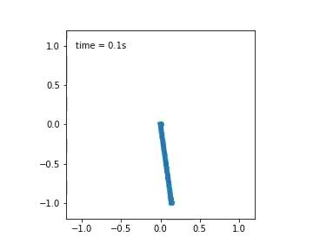
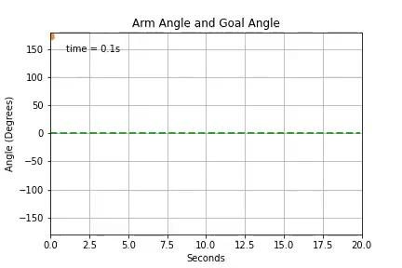
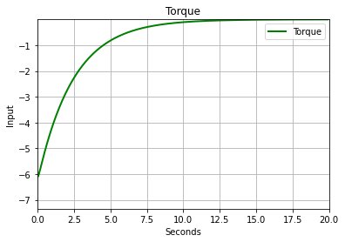
Task: Upright Arm P Controller Performance
Most Likely Arm Control (P is just right)

Slide 14
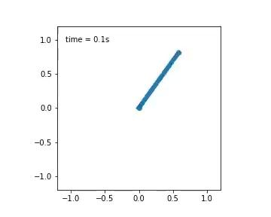
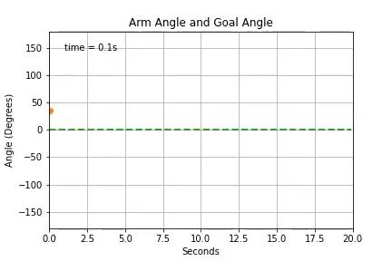
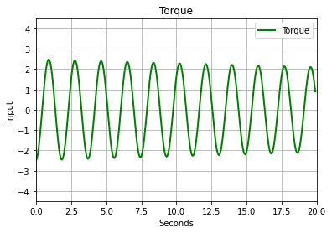

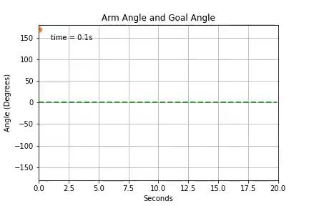
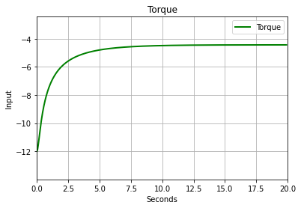
Task: Upright Arm P Controller Performance
Overshooting Oscillations (P is too large)
Undershooting (P is too small and gravity)

Slide 15
PD Control: Idea for Adding Controller Resistance
Problems:
How do we penalize the arm when it is moving too quickly and might overshoot?
How do we stop oscillations?
Analysis:
Large velocity cause overshoot and oscillations
Solution:
Penalize the velocity when it is too large.
PD Control Algorithm
Goal (Set point): 0゜
Control Logic Rules:
u = - P * θ - D * v
Scaling value D is added
0゜
-90゜
-u
+u
90゜
+-180゜

Slide 16

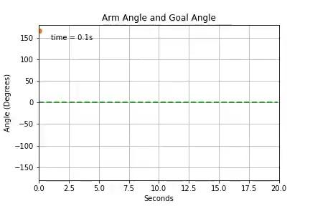
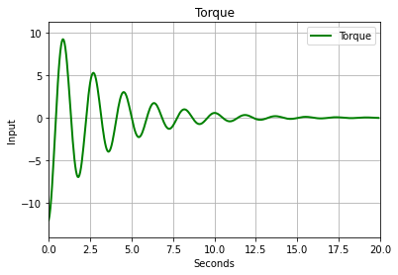
Task: Upright Arm PD Controller Performance
Most Likely Arm Control (Without D)
Most Likely Arm Control (D is just right)

Slide 17
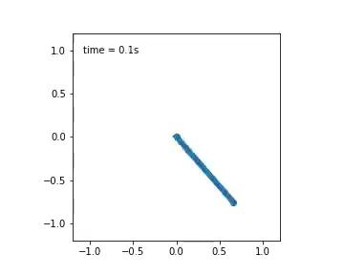
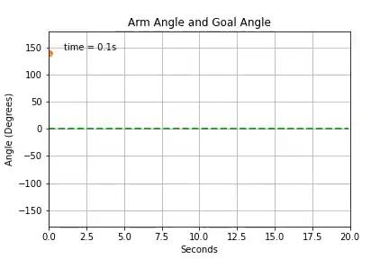
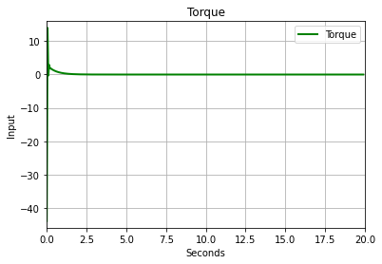

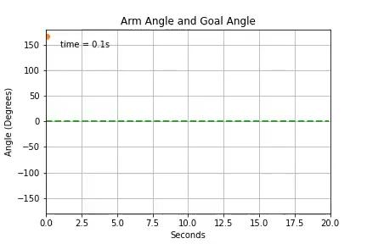
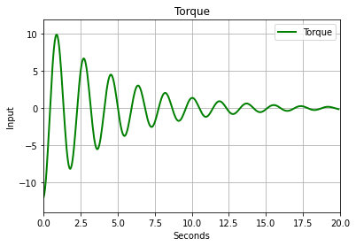
Task: Upright Arm PD Controller Performance
Slow (D is large)
P Controller (D is too small or insufficient)

Slide 18
Fixing a Stuck Controller
Design Goal: Recover pendulum from stuck locations
Problems:
Controller could settle away from the set point (steady-state error)
0゜
u = 90
Analysis:
Example: P = 1 and θ = 90
u = 1 * 90 = 90
When V is near 0 at θ = 90, the force of the controller and gravity can cancel out (depending on the mass)
Result: A stuck controller
-90゜
+u
90゜
g = 90
+-180゜

Slide 19
Task: Upright Pendulum PID Controller
Design Goal: Recover pendulum from stuck locations
0゜
PID Control Algorithm
Goal (Set point): 0゜
Control Logic Rules: Scaling value I is added
u = - P * θ - D * v - I * (accumulated error)
-90゜
-u
+u
90゜
+-180゜
Describe control as the variable u
+ u turns clockwise
- u turns counterclockwise

Slide 20
Accumulating Error and Notes
Keeping track of accumulating error
For every measurement of θ, add θ to an accumulating sum.
Goal: 0゜
Time (s) | θ (degrees) | Accumulated Error
1 | 90 | 90
2 | 90 | 180
3 | 80 | 260
4 | 50 | 310
Things to think about:
What to do if error keeps on accumulating?
How to stop error from getting too large?

Slide 21
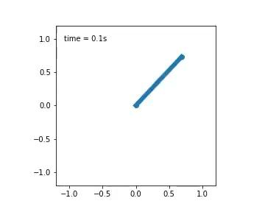
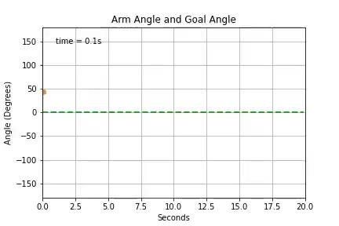
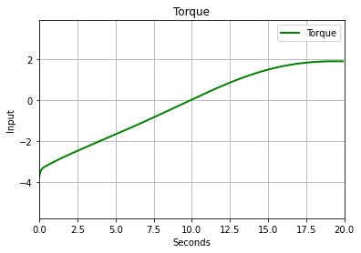
Task: Upright Arm PID Controller Performance
PD Controller (Without I)
Good Pendulum Control (With I)

Slide 22

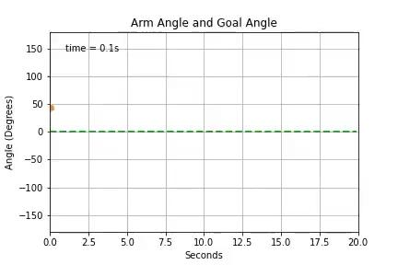
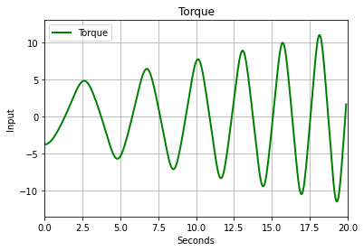

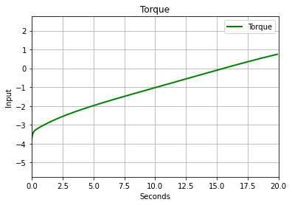
Task: Upright Arm PID Controller Performance
Overshooting Oscillations (I is too large)
Delayed Effect (I is too small)

Slide 23
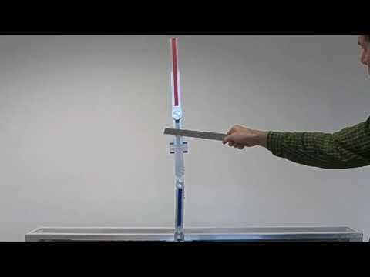
What other problems are there?
Controllability
Is there a way to control a system?
Stability
Would a system be able to stay in place by itself or with
a controller?
Optimality
Is this the best solution in
terms of time or other criteria?
Feasibility
Is this solution reasonable to
implement?
Reachability
Left alone, where will a controller
go?
Safety
Will a controller always behave
safely?
https://www.youtube.com/watch?v=meMWfva-Jio

Slide 24
Coding session in Colab
Please go to this link:
https://tinyurl.com/2fwc9fp2

Slide 25



Thank you!
Resources
Workshop Colab Notebook: https://tinyurl.com/2fwc9fp2
Workshop Slides: https://tinyurl.com/yncj4tjn
Cart Pole Simulation: https://robotic-controls.com/static/inverted-pendulum/
Upcoming RoboLaunch Talks: https://riss.ri.cmu.edu/robolaunch/
Past talks and more: https://www.youtube.com/channel/UC0iLihY7u36PRFrmydG5J7A

